Slide 1
Date: 18/12/2023
Realized by : Slaheddine JOUILA

Slide 2
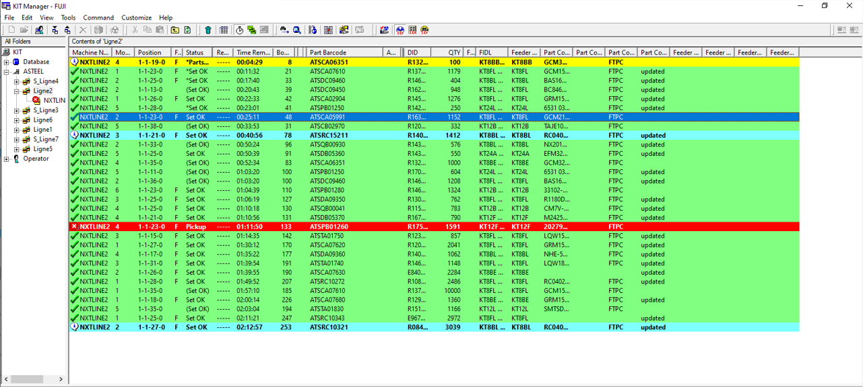
I)Manual adding quantitys (kit manager)
Need to limit access on KIT MANAGER, to no add the quantity of the component manually ➔ Fuji Not Feasible with current SOFTWARE
Asteel:we maintain our request and we wait for your proposal of software developpement.
FUJI>> Kit Manager is part of Fujitrax. Fujitrax doesn’t have User management. It will be removed from Nexim in the Future. Please use Nexim Kittingstation NKS. In Nexim you can use the user permission to limit operators access.
Asteel:OK validated.

Slide 3
II) Dynamic AVL
AVL ( package) between the width of tape: we want to have a solution to use different tapes ( 12mm &16mm) for the same part. (Dynamic AVL function exist in NEXIM ) ( a slot of time will be scheduled to validate)
Asteel:Validation on going with ATD (issues encountered that need to be resolved).
2) AVL (Package) between tape and reel : to change between tray and reel for the same part.( Fuji: Not possible with the current software )➔ ASTEEL: we wait for your proposal of development .
Fuji>> Wait for Feedback from Fuji Japan
Fuji : Will communicante a deadline to have a solution.
3) AVL shape : for the same part we change the shape ( second source) ( Fuji: Not possible with the current software )➔ ASTEEL :we wait for your proposal of development.
Fuji>>can be changed during production using Medit. Part Data Change Function.pdf
Asteel: this solution is done manually on M-edit, is not dynamic so it does not meet our needs.
Fuji: propose to stop only the module in wich we make a modification.
Asteel: The solution doesn’t fit to our needs because we need to scrap all the Panel.

Slide 4
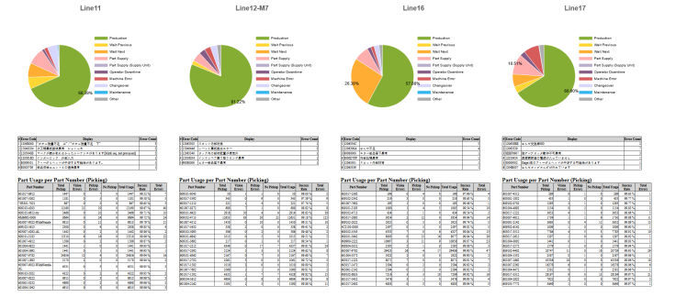
III) Reject Report
1- How do i extract the report of components rejects on NEXIM by line and by total SMT equipments?
There is no Setting to include all reports in one file
>>External Tool from Fuji Japan. Check if this would be enough. Check the samples.
Asteel:Thes exemples are insufficient and too general for us, in fact we need other details so that we can carry out process analyses, for each part number we must add other columns which indicate : the program associated with it, the machine, the module, the date and the time.
2- Asteelflash :How to automatically extract the Analysis report for a week ?
FUJI : It’s not possible for Analysis Report. But you can use the standard Weekly Report. Please check it.
Asteelfash : it’s out of our request by this report.
>> only daily report possible.
Asteel: We maitain our request as did in Flexa.

Slide 5
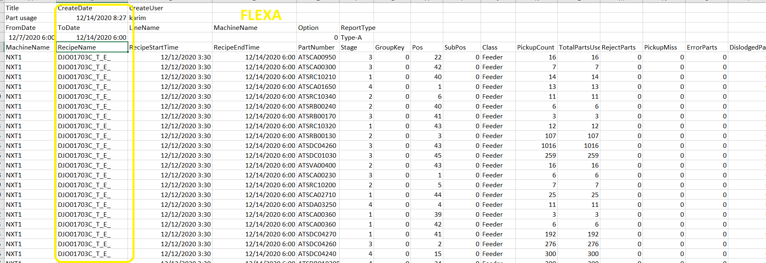
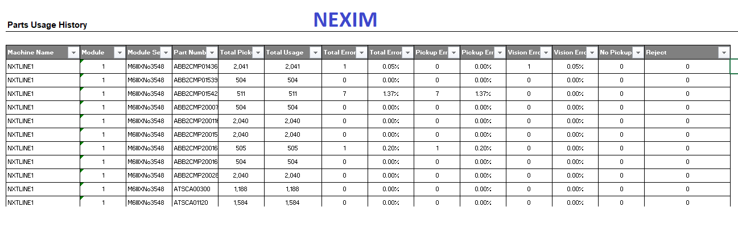
III) Reject Report
See below the difference between FLEXA and NEXIM
III)-1 We need to Add the Receipe Name ( JOB) as exist with Flexa.

Slide 6
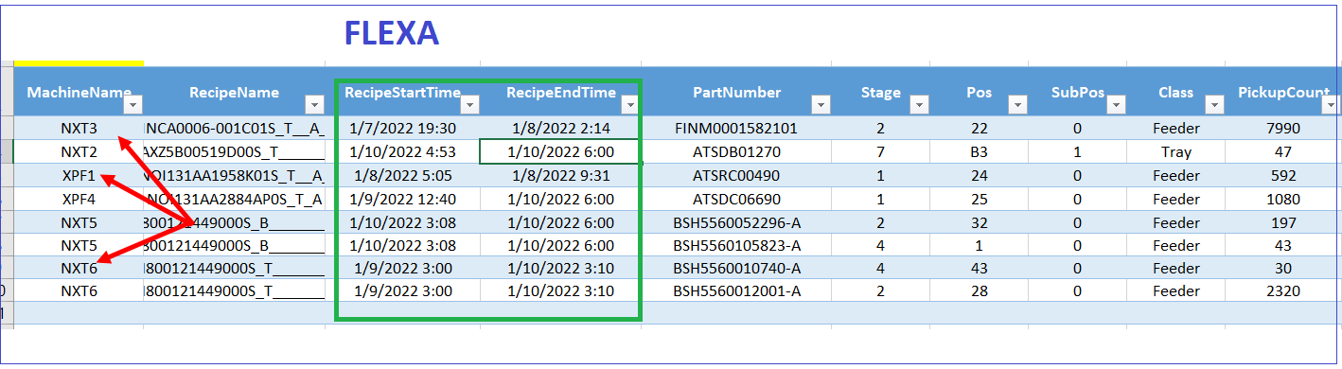
III) Reject Report
III)-2 START TIME/ END TIME of pick up:
On flexa report the pick up time exists in front of each component in the table but in NEXIM the time displayed on the file header.
.

Slide 7
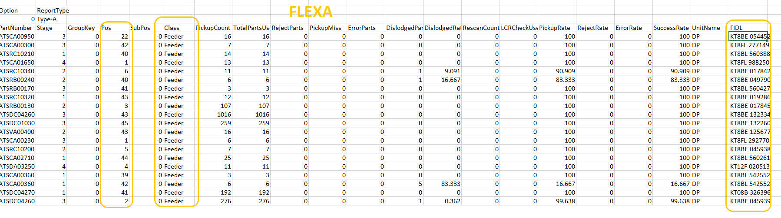
III) Reject Report
III)-3 Feeder position:
On flexa the feeder position exists in front of each component in the table but in NEXIM but in Nexim doesn’t exist.

Slide 8
IV) MODIFICATION JOB IN REAL TIME
Modification Job in real time on production:
In Flexa, we can do it
In Nexim, we cannot do it we must pass by M-edit or we must empty the line from panel to load the new Job with the modifications.
Fuji: The synchronisation between M-edit and Nexim not recommended and not feasible.
Asteel: we do not agree with this idea, as a customer we judge that this option is necessary and we expect action from Fuji.
FUJI>> the risk to make trouble inside the machine when using this function is too high.
Asteel: we don’t agree we used the same machines with Flexa and we haven’t any problem➔the problem came from Nexim.
Fuji: Propose that Asteel send an example of our needs.
Asteel: You find attached a template of the reject table that we need and that contain data and Rows for all the SMT parc.

Slide 9
V) DASHBOARD
Asteelflash : on NEXIM Dashboard, We ask how to dispolay production data for a period of up to 24h ? FUJI : Due to performance issues, Fuji decided to show max. 4h. Otherwise we cannot guarantee working Management Monitor.
Asteelflash : we maintain our request and we wait for an action from Fuji.
Fuji>> data are to monitor the current product/Job. It doesn’t make sense to change the period to 24h. Check old data can be done in th reports or in Accessory Software production data.
Asteel: OK is it possible to change the period to 8H in order to have dashboord for a whole shift?
Fuji: Possible to have display for a period of 8 H.
Asteel: We wait for your reply

